Slide 1
JavaScript Skills Workshop
Day 3

Slide 2

JavaScript Teacher Manual
https://drive.google.com/file/d/1KAogeP681Swo2EyVXoCx84gak00Yyd8u/view?usp=sharing

Slide 3
let country = prompt("Enter a country and I will tell you its capital");
Select the correct if-statement for an input of Ireland
A
if (country == "Ireland"):
console.log("Dublin");
B
if (country == "Dublin") {
console.log("Ireland");
}
C
if (country == "Ireland") {
console.log("Dublin");
}
D
if (country = "Ireland"):
console.log("Dublin");
E
if (country == 'Ireland')
console.log("Dublin");
F
if (country = "Ireland")
console.log("Dublin");
Notes:
Answer / Syntax notes:
A is incorrect – colon is an unexpected symbol
B compares the string which was entered to Dublin
C is correct – good practice to use curly braces even though there is only one statement in the body
D – colon is unexpected BUT assignment works
E is fine – single and double quotes can be used for strings – braces not needed because only one statement in loop body
F is an assignment – usually evaluate to true (unless a falsey value – zero, null etc)

Slide 4
let country = prompt("Enter a country and I will tell you its capital");
Select the correct if-statement for an input of Ireland
A
if (country == "Ireland"):
console.log("Dublin");
B
if (country == "Dublin") {
console.log("Ireland");
}
C
if (country == "Ireland") {
console.log("Dublin");
}
D
if (country = "Ireland"):
console.log("Dublin");
E
if (country == 'Ireland')
console.log("Dublin");
F
if (country = "Ireland")
console.log("Dublin");
Notes:
Answer / Syntax notes:
A is incorrect – colon is an unexpected symbol
B compares the string which was entered to Dublin
C is correct – good practice to use curly braces even though there is only one statement in the body
D – colon is unexpected BUT assignment works
E is fine – single and double quotes can be used for strings – braces not needed because only one statement in loop body
F is an assignment – usually evaluate to true (unless a falsey value – zero, null etc)

Slide 5

Battleship

Slide 6
Battleship
The aim is to sink the battleship
?
?
?
?
?
?
… user enters a guess
 |  | MISS!
?
?
?
?
?
… user enters another guess
 |  | MISS!
?
?
?
?
… and so on until ….
 |  | MISS!
?
?

Slide 7
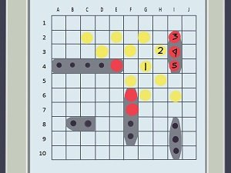
Evaluation

Slide 8
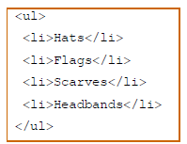
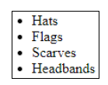
Document Object Model (DOM)
HTML View
User View
DOM View
Notes:
Manual pg. 213

Slide 9
Document Object Model (DOM)
document
A DOM tree is a browser’s representation of a web page
DOM nodes can be related to each other as parents, children and siblings
html
head
body
title
h1
ul
h2
p
br
p
script
li
li
li
li
b
i
Memory (JavaScript) representation of the HTML shown on page 210
Notes:
This is a memory/JavaScript representation of the HTML shown on page 210

Slide 10
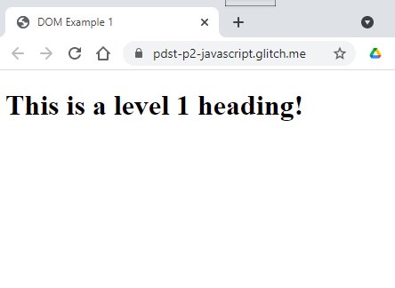

DOM Application Programming Interface (API)
<! You should rename this file index.html to run it -->
<!DOCTYPE html>
<html>
<head>
<title>DOM Example 1</title>
</head>
<body id="body-id">
<script>
// create a new h1 element
let h1Elem = document.createElement("h1");
// set the h1 element’s text conten
h1Elem.textContent = "This is a level 1 heading!";
// insert the new h1 element as a child of body
let bodyElem = document.getElementById("body-id");
bodyElem.appendChild(h1Elem);
</script>
</body>
</html>

Slide 11
DOM Application Programming Interface (API)
<! You should rename this file index.html to run it -->
<!DOCTYPE html>
<html>
<head>
<title>DOM Example 1</title>
</head>
<body id="body-id">
<script>
// create a new h1 element
let h1Elem = document.createElement("h1");
// set the h1 element’s text conten
h1Elem.textContent = "This is a level 1 heading!";
// insert the new h1 element as a child of body
let bodyElem = document.getElementById("body-id");
bodyElem.appendChild(h1Elem);
</script>
</body>
</html>
document
html
head
body
body-id
title
script
“DOM Demo 2”

Slide 12
DOM Application Programming Interface (API)
<! You should rename this file index.html to run it -->
<!DOCTYPE html>
<html>
<head>
<title>DOM Example 1</title>
</head>
<body id="body-id">
<script>
// create a new h1 element
let h1Elem = document.createElement("h1");
// set the h1 element’s text conten
h1Elem.textContent = "This is a level 1 heading!";
// insert the new h1 element as a child of body
let bodyElem = document.getElementById("body-id");
bodyElem.appendChild(h1Elem);
</script>
</body>
</html>
document
html
head
body
body-id
title
script
h1
“DOM Demo 2”

Slide 13
DOM Application Programming Interface (API)
<! You should rename this file index.html to run it -->
<!DOCTYPE html>
<html>
<head>
<title>DOM Example 1</title>
</head>
<body id="body-id">
<script>
// create a new h1 element
let h1Elem = document.createElement("h1");
// set the h1 element’s text conten
h1Elem.textContent = "This is a level 1 heading!";
// insert the new h1 element as a child of body
let bodyElem = document.getElementById("body-id");
bodyElem.appendChild(h1Elem);
</script>
</body>
</html>
document
html
head
body
body-id
title
script
h1
“DOM Demo 2”
This is a level 1 heading

Slide 14
DOM Application Programming Interface (API)
<! You should rename this file index.html to run it -->
<!DOCTYPE html>
<html>
<head>
<title>DOM Example 1</title>
</head>
<body id="body-id">
<script>
// create a new h1 element
let h1Elem = document.createElement("h1");
// set the h1 element’s text conten
h1Elem.textContent = "This is a level 1 heading!";
// insert the new h1 element as a child of body
let bodyElem = document.getElementById("body-id");
bodyElem.appendChild(h1Elem);
</script>
</body>
</html>
document
bodyElem
html
head
body
body-id
title
script
h1
“DOM Demo 2”
This is a level 1 heading

Slide 15
DOM Application Programming Interface (API)
<! You should rename this file index.html to run it -->
<!DOCTYPE html>
<html>
<head>
<title>DOM Example 1</title>
</head>
<body id="body-id">
<script>
// create a new h1 element
let h1Elem = document.createElement("h1");
// set the h1 element’s text conten
h1Elem.textContent = "This is a level 1 heading!";
// insert the new h1 element as a child of body
let bodyElem = document.getElementById("body-id");
bodyElem.appendChild(h1Elem);
</script>
</body>
</html>
document
bodyElem
html
head
body
body-id
title
script
h1
“DOM Demo 2”
This is a level 1 heading

Slide 16

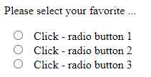
Events / Event Handling
Push Button (click event)
Check Box (push me!)
Check Box (check me!)
Notes:
Other events include loss or gain Focus / mouse move etc

Slide 17


Events / Event Handling
7
The handler function displays Hello World!
1
<button id= "btn-id" type="button">Click me!</button>
// Display a message
function displayMessage() {
alert( "Hello World!" );
}
The HTML code tells the browser to display a button
The user clicks the button and fires the event
4
The fired event is ‘caught’ by JavaScript
2
The JavaScript code registers an event handler called displayMessage with the JavaScript sub-system.
The handler is called
5
6
const btnRef = document.getElementById("btn-id");
btnRef.addEventListener("click", displayMessage);
The code says: “Call displayMessage when the user clicks the button”
3
The JavaScript sub-system listens for events

Slide 18
Events / Event Handling
Example 1 Page 224-225
Example 2 Page 226
BREAKOUT – examples 3 and 4
Notes:
Radio Button (push me!)

Slide 19
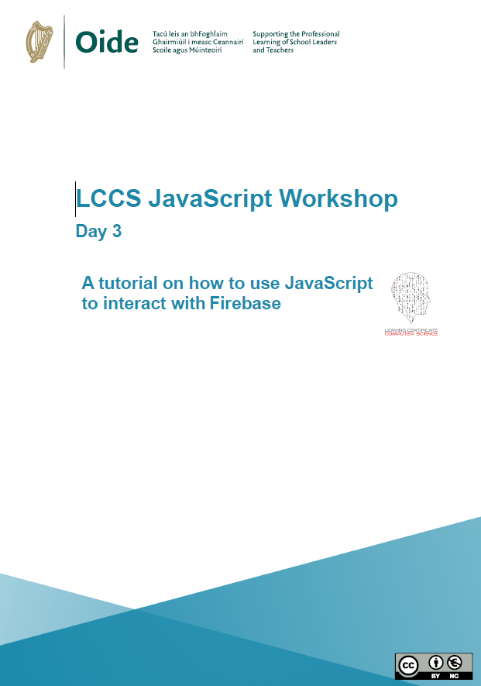
JavaScript Firebase Tutorial
https://drive.google.com/file/d/1FJKTIwYtkwUTTOY9YLZVb83JLwe6tcYk/view?usp=sharing

